Slide 1
Relationships and Sex Education at Ewelme C.E. Primary School
Information meeting for parents
Thursday 6th May 2021
Thank you for joining, the meeting will begin shortly

Slide 2
Objectives of this session:
To share our approach for delivering Relationships and Sex Education (RSE) as part of our PSHE curriculum
To share detailed examples of our lessons plans and resources for sex education at different ages
To ensure parents/guardians are well-informed about RSE at Ewelme and therefore able to support their children as required
To ensure parents/guardians understand their statutory right to withdraw their children from aspects of the RSE curriculum and the process for ascertaining this right

Slide 3
What is P.S.H.E.?
Personal, Social, Health, Economic Education
Relationships: Families and friendships; Safe relationships; Respecting ourselves and others
Living in the wider world: Belonging to a community; Media literacy and digital resilience; Money and work
Health and Wellbeing: Physical health and Mental wellbeing; Growing and changing; Keeping safe

Slide 4
What is P.S.H.E.?
Personal, Social, Health, Economic Education
Relationships: Families and friendships; Safe relationships; Respecting ourselves and others
Living in the wider world: Belonging to a community; Media literacy and digital resilience; Money and work
Health and Wellbeing: Physical health and Mental wellbeing; Growing and changing; Keeping safe

Slide 5
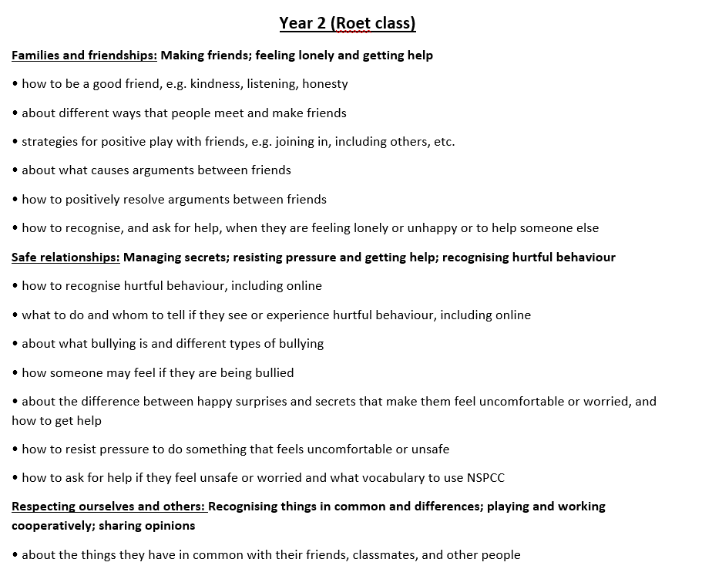
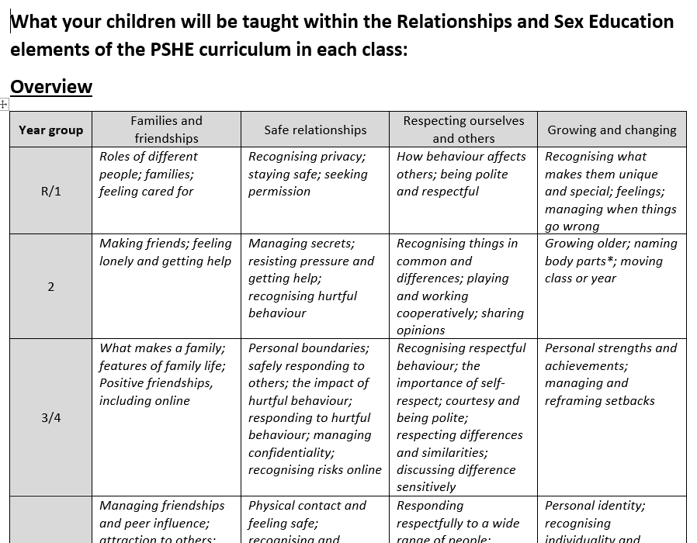

Slide 6
Changing and growing – from YR/1 to Y6
Reception and Year 1 (Chaucer class)
Recognising what makes them unique and special; feelings; managing when things go wrong
to recognise what makes them special and unique including their likes, dislikes and what they are good at
how to manage and whom to tell when finding things difficult, or when things go wrong
how they are the same and different to others
about different kinds of feelings
how to recognise feelings in themselves and others
how feelings can affect how people behave

Slide 7
Changing and growing – from YR/1 to Y6
Year 2 (Roet class)
Growing older; naming body parts; moving class or year
about the human life cycle and how people grow from young to old
how our needs and bodies change as we grow up
to identify and name the main parts of the body including external genitalia
about change as people grow up, including new opportunities and responsibilities
preparing to move to a new class and setting goals for next year

Slide 8
Changing and growing – from YR/1 to Y6
Year 3 and 4 (Burghesh class)
Personal strengths and achievements; managing and reframing setbacks
that everyone is an individual and has unique and valuable contributions to make
to recognise how strengths and interests form part of a person’s identity
how to identify their own personal strengths and interests and what they’re proud of (in school, out of school)
to recognise common challenges to self-worth e.g. finding school work difficult, friendship issues
basic strategies to manage and reframe setbacks e.g. asking for help, focusing on what they can learn from a setback, remembering what they are good at, trying again

Slide 9
Changing and growing – from YR/1 to Y6
Year 3 and 4 (Burghesh class)
Personal strengths and achievements; managing and reframing setbacks
that everyone is an individual and has unique and valuable contributions to make
to recognise how strengths and interests form part of a person’s identity
how to identify their own personal strengths and interests and what they’re proud of (in school, out of school)
to recognise common challenges to self-worth e.g. finding school work difficult, friendship issues
basic strategies to manage and reframe setbacks e.g. asking for help, focusing on what they can learn from a setback, remembering what they are good at, trying again

